Slide 1

Admiral Arithmetic
Kids love it!
Group 7

Slide 2
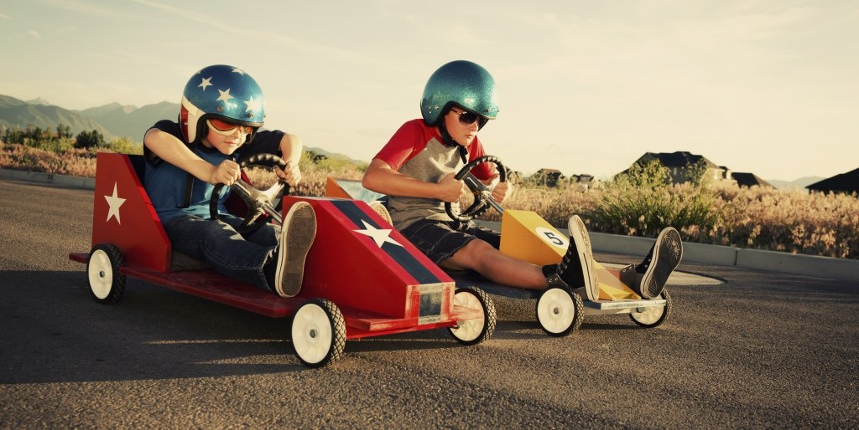
Motivation
-Inspiration comes from our various lab sessions
-Real-time competition between peers
-Capitalizes on children’s competitive nature in games

Slide 3
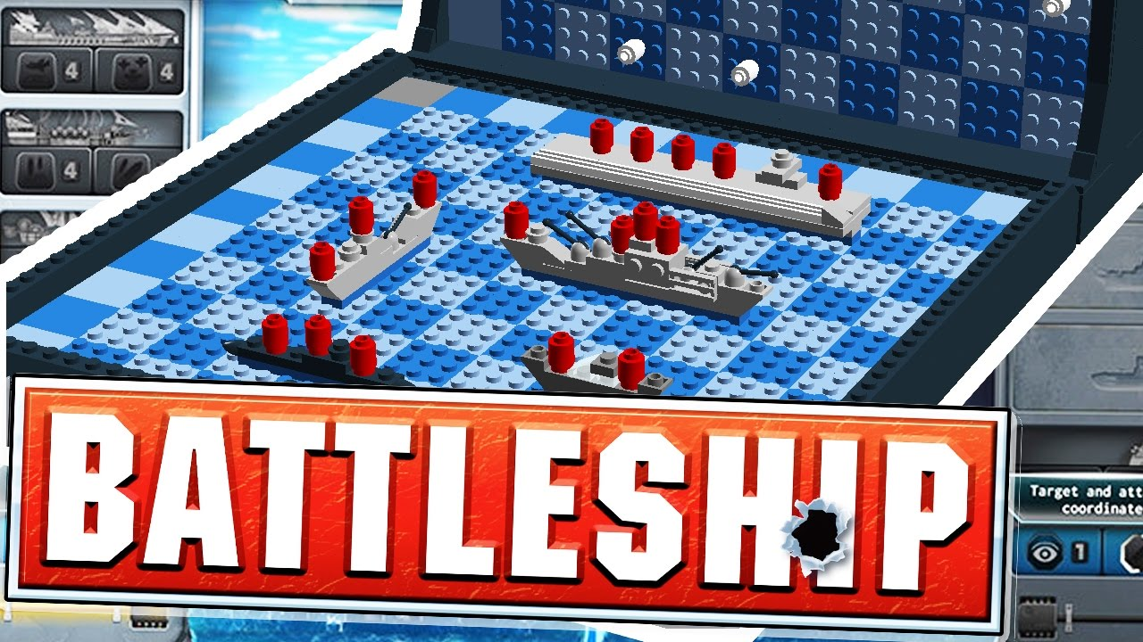
Idea
Integrating a simple and engaging game mechanic with primary school subjects, i.e. primary school math (in our demo)
Adapting the straightforward game of Battleship

Slide 4
Constraints
-We wanted to have a 2 player - Pi system communicating with each other through the server. However, due to ‘faulty’ Pis and lack of two display monitors, we could only experiment and work on one Pi at a time.
-Also, commercially-available LED matrixes were not made available to us during the event, hence, limiting our design of the Pi - client side circuit, which only can work via ‘blinking’ LEDs instead of continuously displaying the circuit.

Slide 5
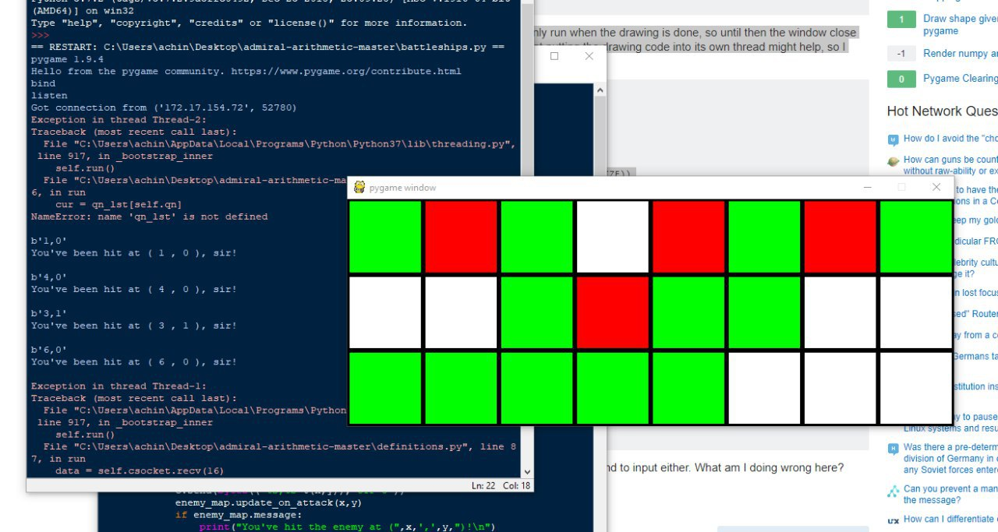
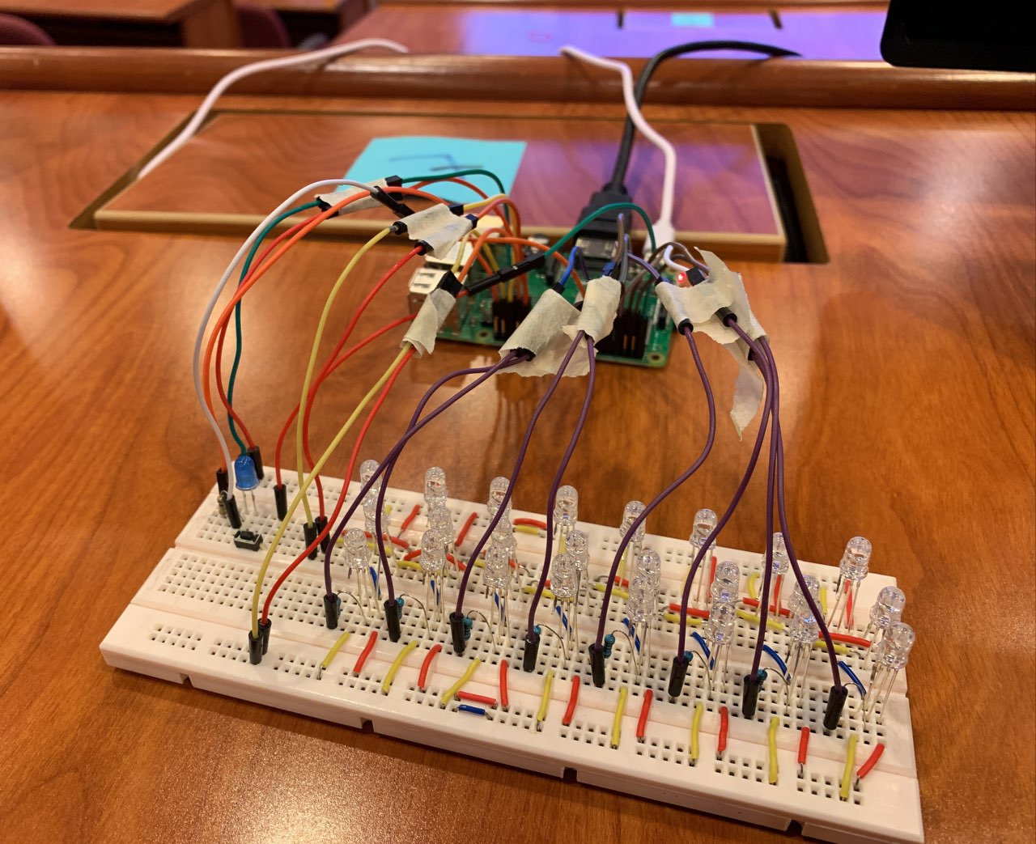
Results

Slide 6
Challenges and Lessons Learnt
Lack of knowledge and experience in socket programming and multithreading in Python and GPIO Programming using the Raspberry Pi
Two of our team members had to pick up Python
Limited controllability for the LED Matrix

Slide 7
Future Improvements or Follow-up
Using a bigger LED matrix with more available rows and columns
Use an LED strip to have better control over the display
Include additional hardware interaction (e.g. buttons to answer multiple choice questions)
More sophisticated GUI
Interface for teachers to scale difficulty, choose arithmetic operation, etc.

Slide 8
Github Repo
https://github.com/RusdiHaizim/admiral-arithmetic
Joseph
Chin Kang
Rohan
Rusdi
Sujay

Slide 9

Bibliography
https://www.youtube.com/watch?v=aQPWubznn2U
https://rockinjump.com/ridgehill/five-tips-make-competition-healthy-kids/
https://www.dreamstime.com/stock-illustration-cartoon-navy-admiral-waving-illustration-image51213832
https://knowyourmeme.com/memes/but-its-honest-work

